Slide 1



European Political Families Data Mining Project
Authors:
Pîrvulescu Anisia
Zvîncă Alexandru - Mihai
Year 3
CTI Eng

Slide 2
Table of contents
01
02
03
04
05
06
Introduction
Dataset Tuning
TF - IDF
N - grams
Language Model
Information Retrival
07
08
09
Sentiment Analysis
Conclusions
Bibliography

Slide 3
Introduction

Slide 4
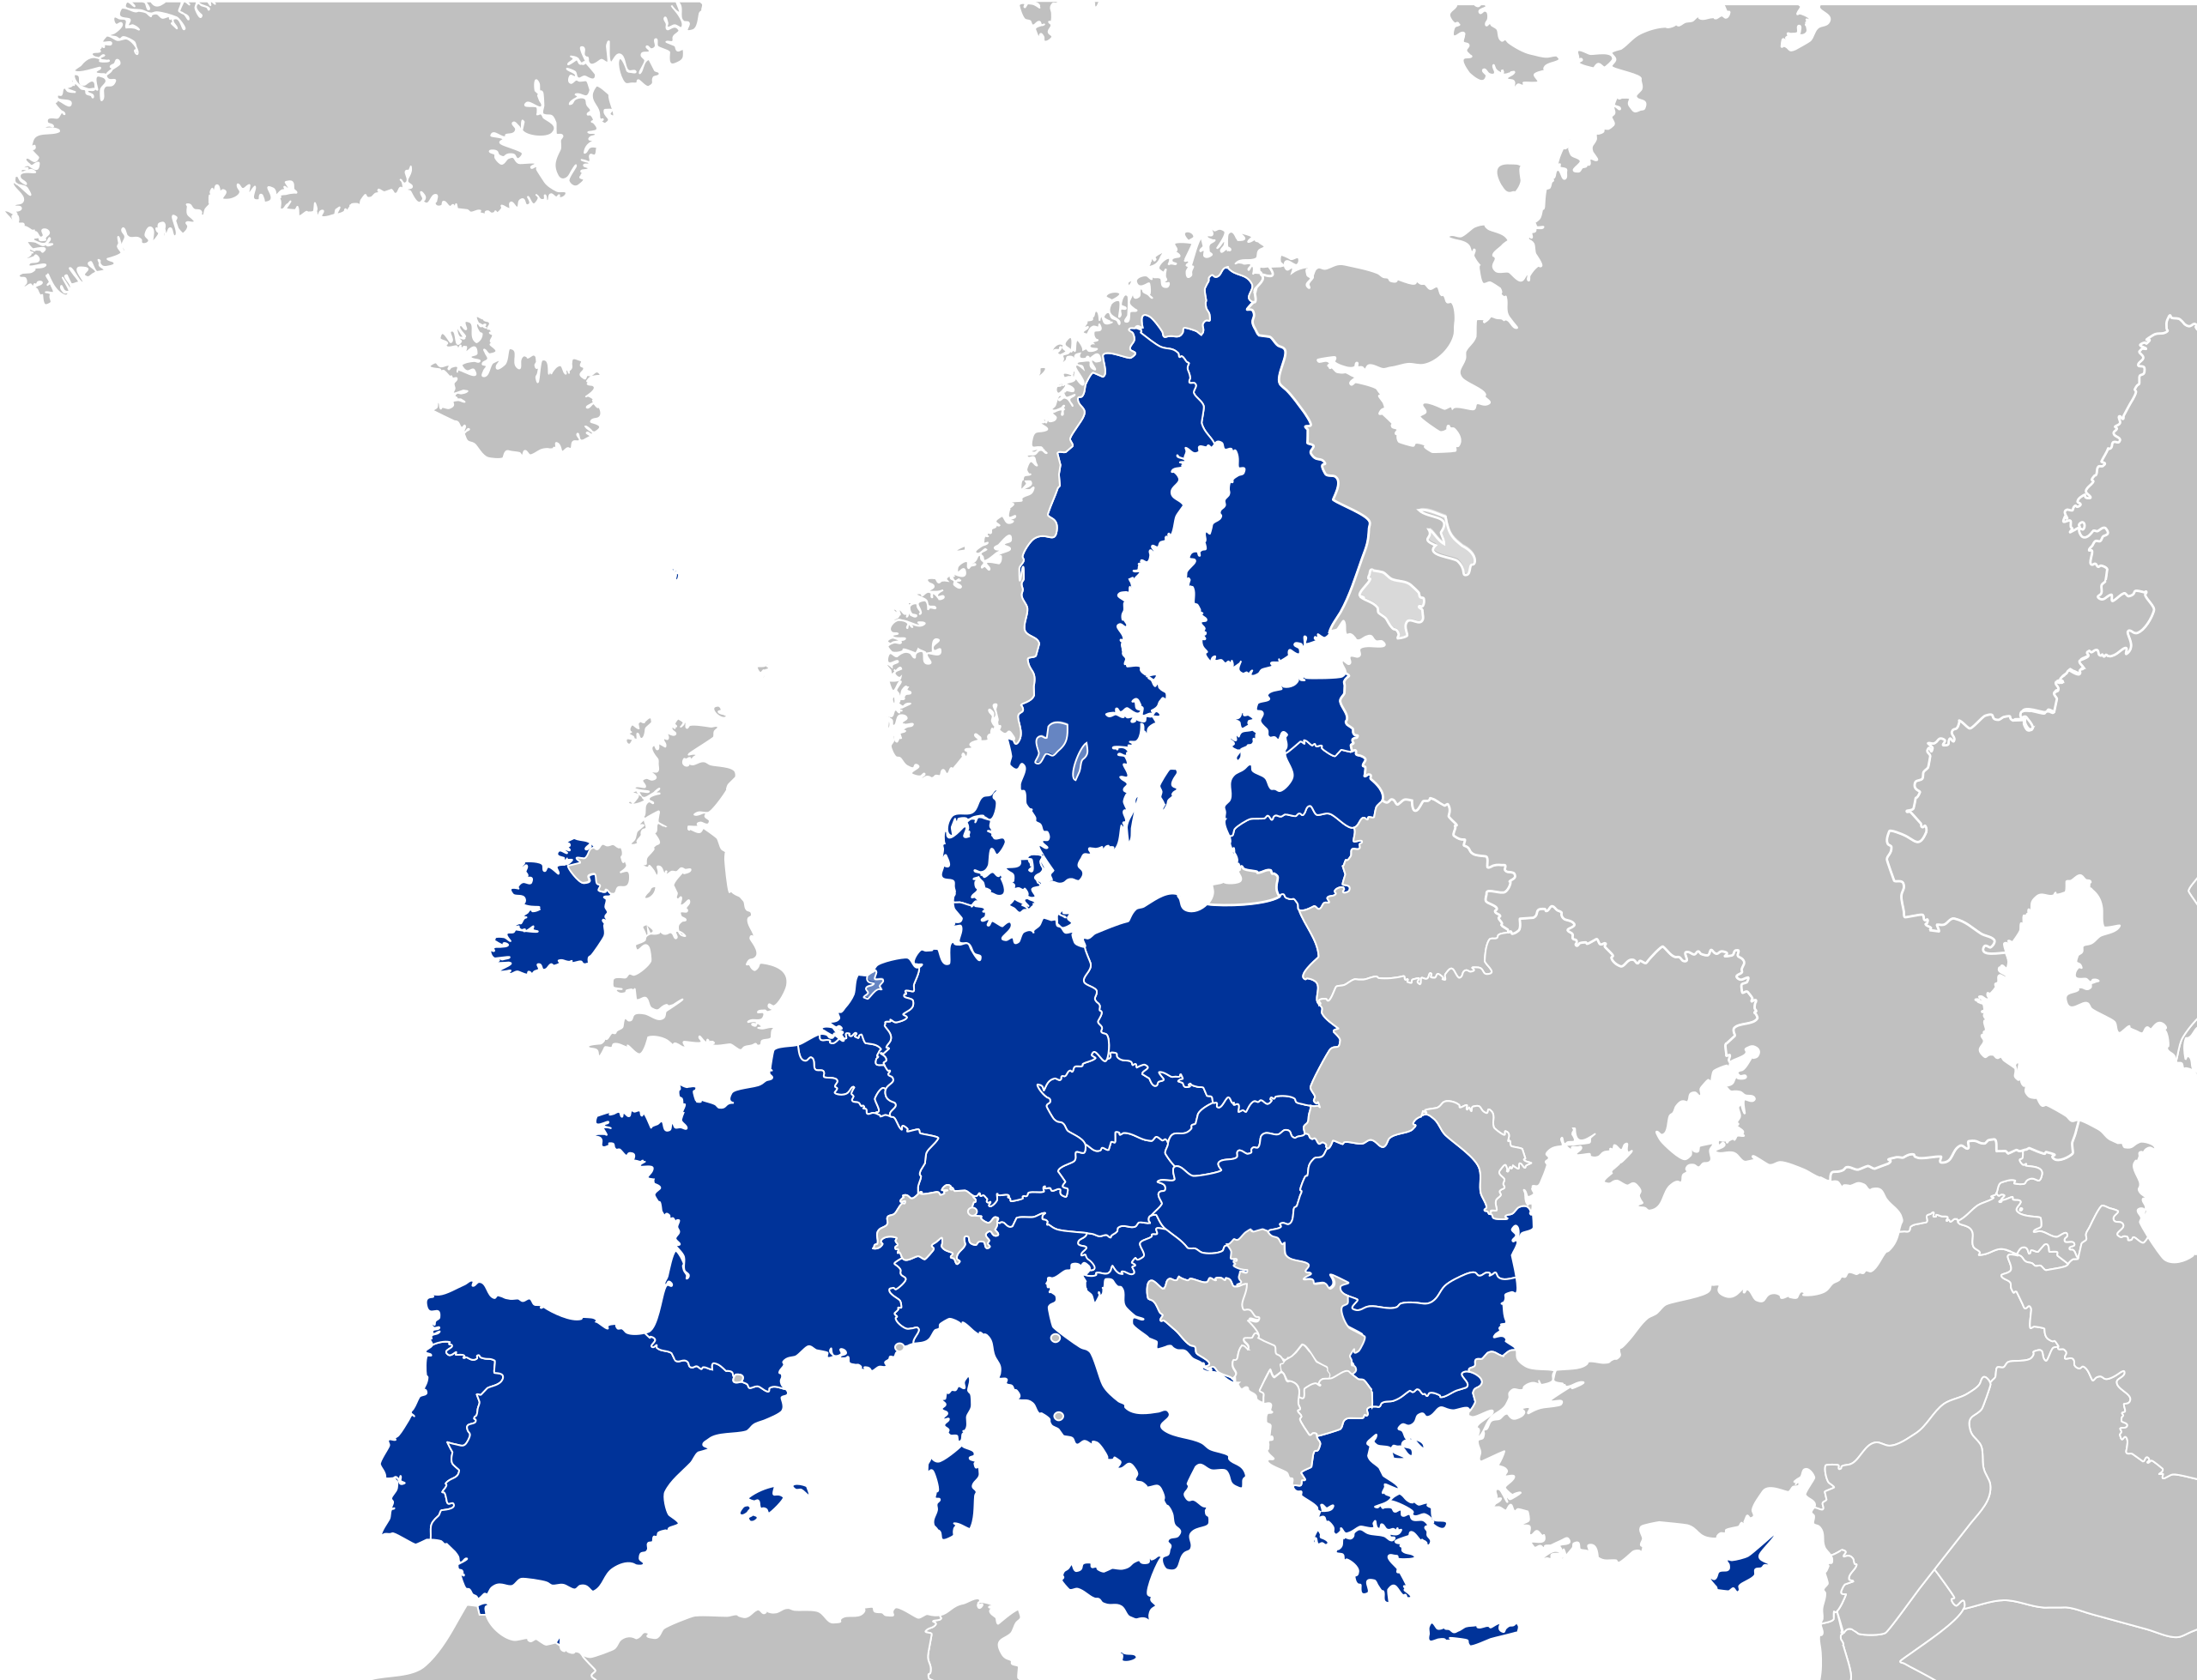
The European Union
Political and Economic Union
27 member states
Officially created in 1993 – Maastricht Treaty
3 main bodies: European Parliament, European Comission, Council of The European Union

Slide 5







European Political Groups

Slide 6
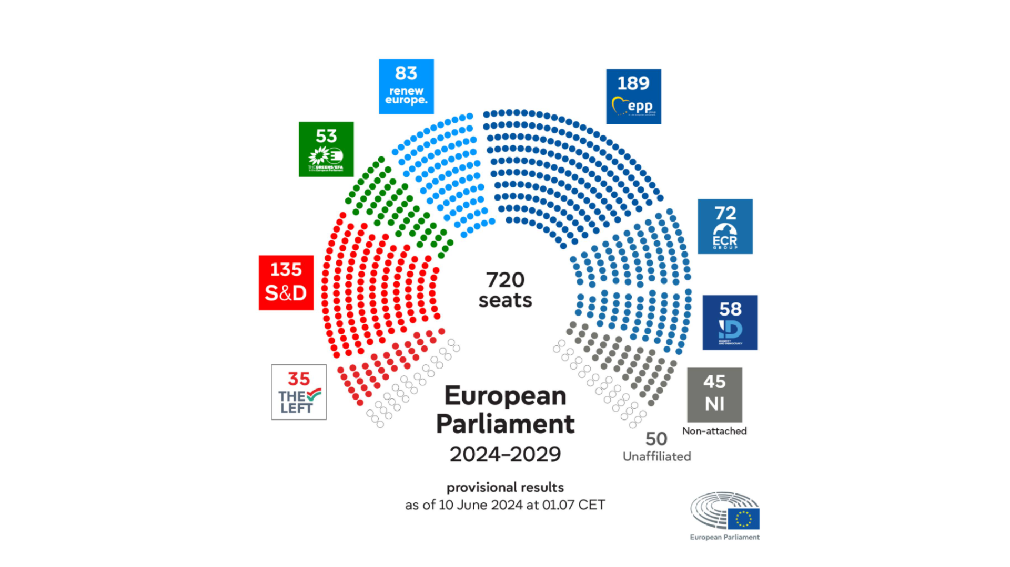
Seats in The European Parliament

Slide 7
Dataset Tuning

Slide 8
Dataset Tuning
1. Data
2. Cleaning
3. Reading
The policital programmes/manifestos of the groups
Stop words extraction and lemmatization
Reading from PDF files and starting the work!

Slide 9
Dataset
Composed of the manifestos of the 7 european polictal groups (7 documents)
214,097
words

Slide 10
Cleaning
Stop Words: european, europe, people, government, country, party, policies etc.
Remove punctuation, numbers and special characters.
All text to lowercase.
Aftwards, we include lemmatization.
Left - Before Cleaning:
1
EUROPEAN ELECTIONS MANIFESTO 2024
2
Principles and Proposals of the European Left
The upcoming elections to the European Parliament will take place under extraordinary circumstances.
Europe has become the fastest warming continent in the world and the phase-out of fossil fuels must be accelerated.
Many European citizens are struggling with a cost-of-living crisis while billions of euros
Left - After Cleaning:
election principle proposal left upcoming election parliament take place extraordinary circumstance become fastest warming continent phaseout fossil fuel
accelerated citizen struggling costofliving crisis billion euro

Slide 11
TF - IDF

Slide 12
TF – IDF The most common words
Left:
housing
market
capitalism
SD:
women
gender
equality
Greens:
courage
green
climate
Renew:
digital
market
rule
EPP:
country
democracy
region
ECR:
ukraine
initiative
development
ID:
union
cooperation
defense

Slide 13
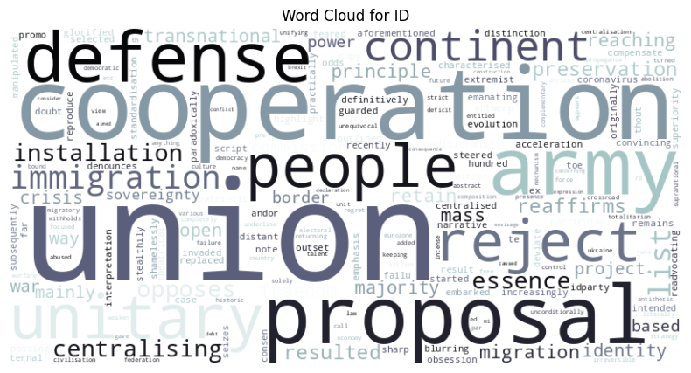
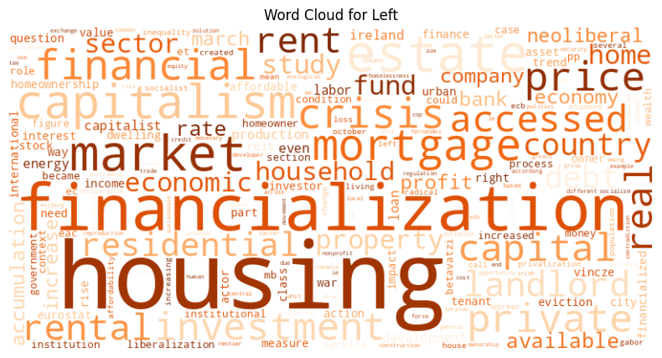

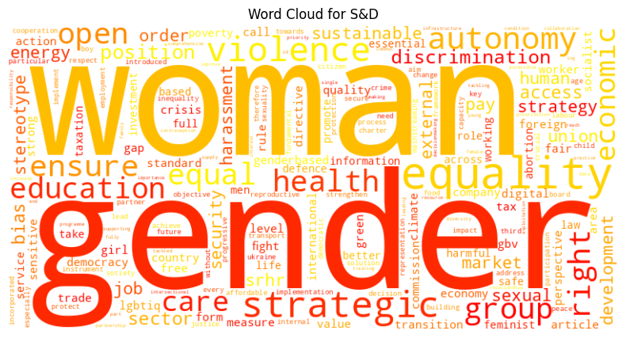
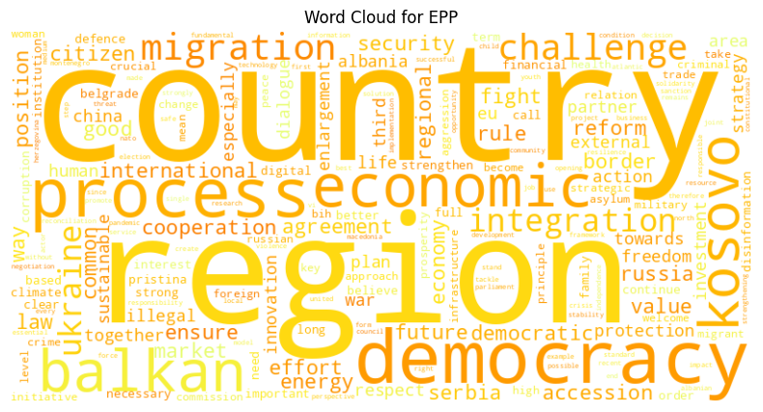
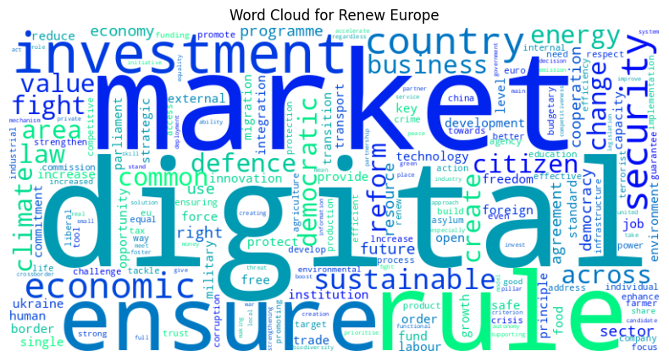
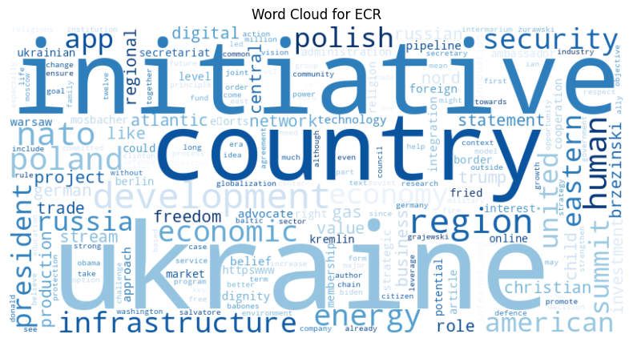
Visualization – Word Clouds

Slide 14
N - grams

Slide 15
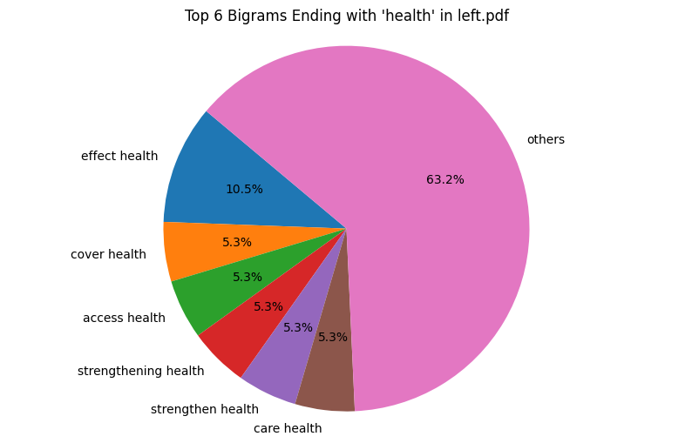
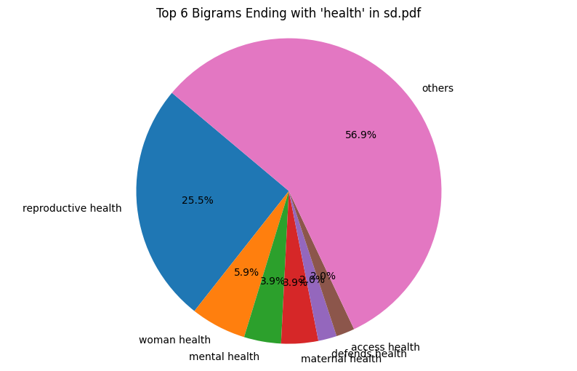
Bigrams
Most common bigrams regarding health

Slide 16
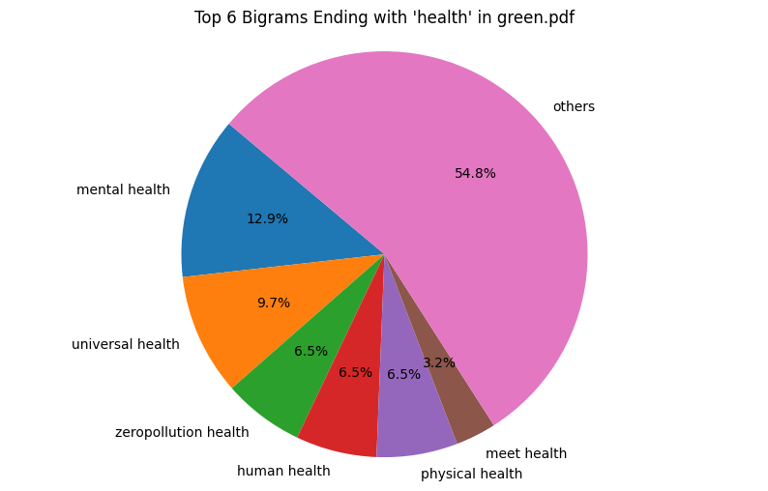
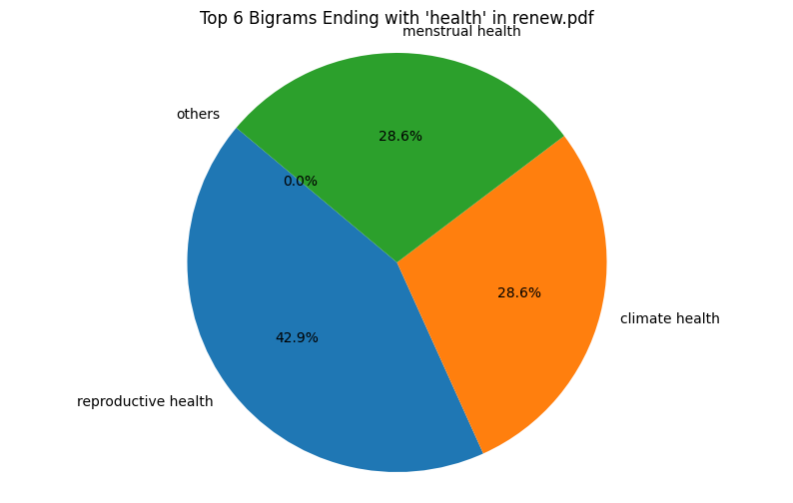
Bigrams
Most common bigrams regarding health

Slide 17
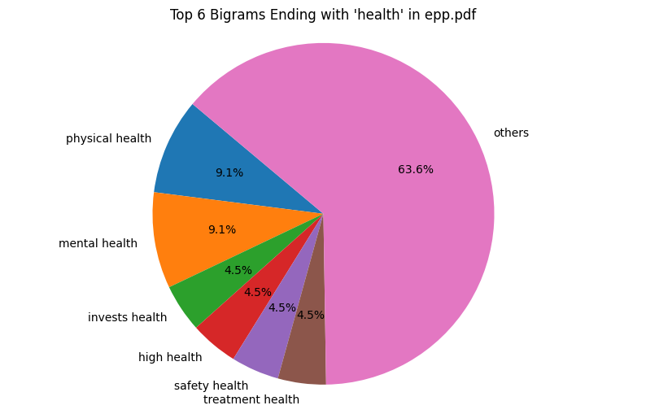
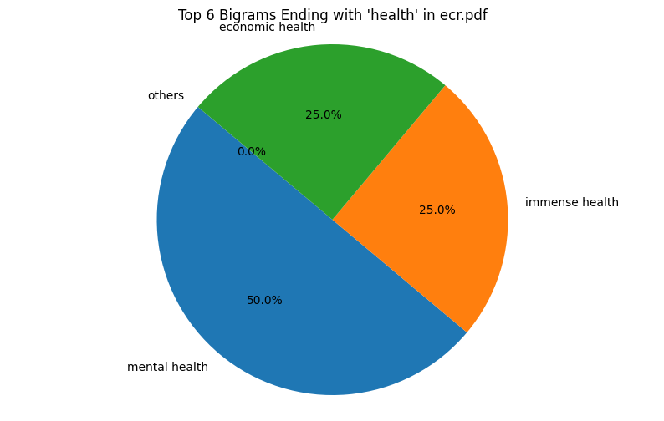
Bigrams
ID do not mention health in their manifesto
Most common bigrams regarding health

Slide 18
Language Model

Slide 19
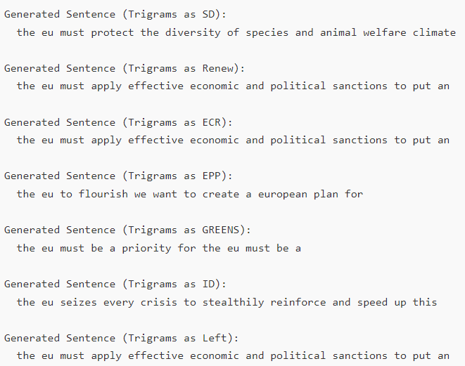
Language Model
We have implemented language models for each political family
From a given word, they can generate phrases that make sense in regard to each political program
Example starting from “the eu”, using trigrams

Slide 20
Information Retrival

Slide 21
Information Retrival
Finding how well each document best matches with our input
For us, similarity means how much our families tackle the proposed subject
We use three methods: Cosine Similarity, BM25, LSI
Chosen input: “war in Ukraine” and “climate change”

Slide 22
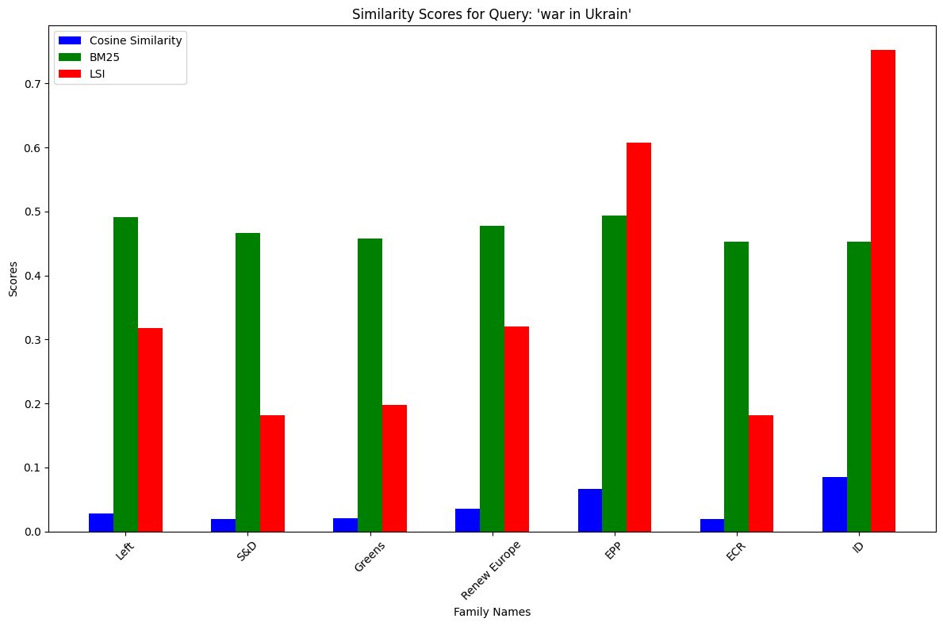
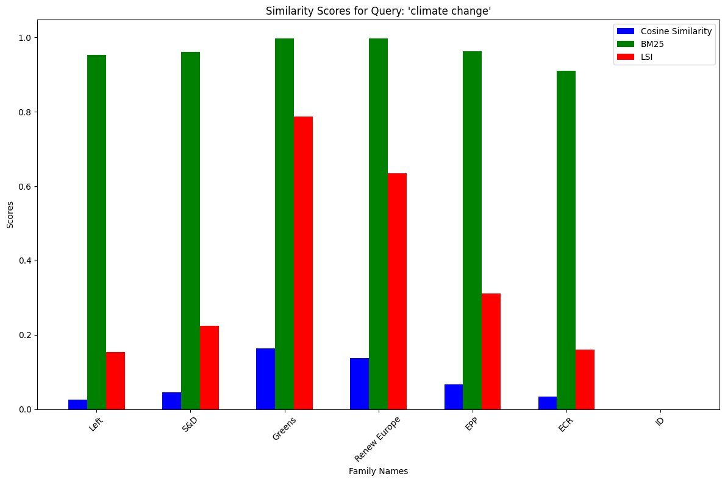
Information Retrival
Chosen input: “war in ukraine” and “climate change”
LSI gives us the most accurate results.
The higher the score, the more preoccupied with this topic the party is.

Slide 23
Sentiment Analysis

Slide 24
Sentiment Analysis
The most predominant emotion in each political plan

Slide 25
Conclusions

Slide 26
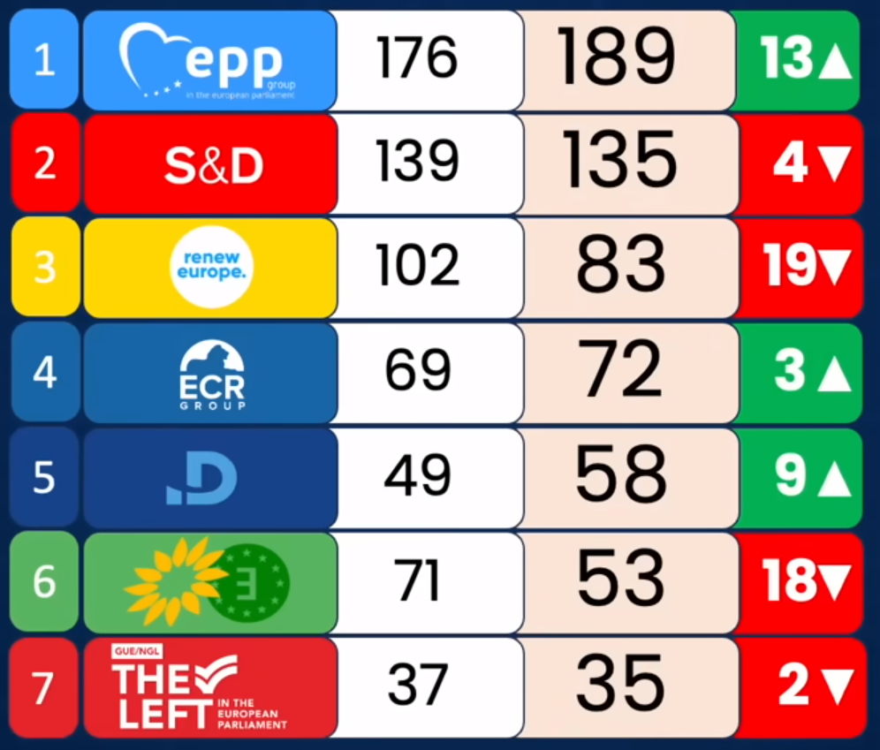
Conclusions
Results of the 2024 EU Elections

Slide 27
Conclusions
Focus on capitalist economy was preferred
Climate action isn’t the priority of most voters
There exists a consensus on helping Ukraine
In total, joy was a better stimulant than fear
A more complex analysis on health leads to more trust from people
Euroscepticism is on the rise

Slide 28
Bibliography

Slide 29
Bibliography
https://www.europarl.europa.eu/portal/en
https://european-union.europa.eu/index_en
https://european-union.europa.eu/principles-countries-history/principles-and-values/aims-and-values_en
https://www.europarl.europa.eu/about-parliament/en/in-the-past/the-parliament-and-the-treaties/maastricht-treaty
https://www.epp.eu/
https://www.socialistsanddemocrats.eu/
https://www.reneweuropegroup.eu/
https://www.aldeparty.eu/
https://www.greens-efa.eu/en/
https://ecrgroup.eu/
https://www.idgroup.eu/
https://www.youtube.com/watch?v=IM8QHYI2r5o
Data Mining Laboratories

Slide 30
Thank you!

